Slide 1
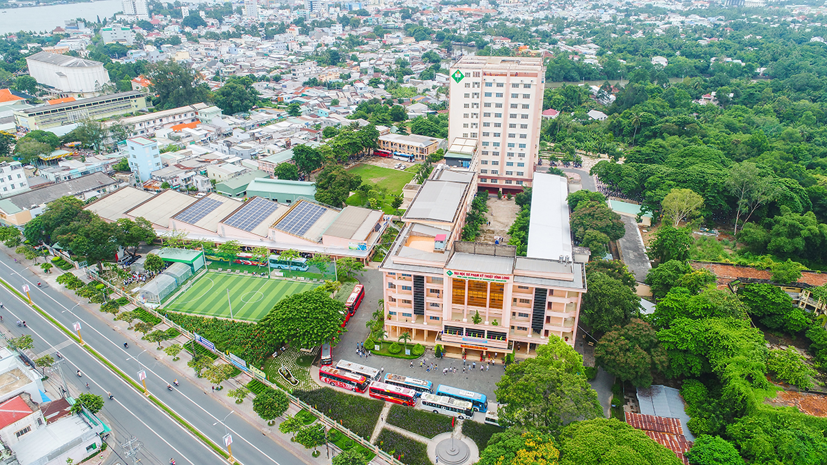

THE INTERNATIONAL CONFERENCE ON MACHINES, ENERGY AND DIGITIZATION FOR SUSTAINABLE DEVELOPMENT – IMEDS2025
EXPLAINABLE ARTIFICIAL INTELLIGENCE (XAI) FOR THE DETECTION AND SEGMENTATION OF MASS ON MAMMOGRAMS USING DEEP LEARNING TECHNIQUES
Ho-Dat TRAN, Thuong-Cang PHAN,
Vinh-Phong NGUYEN, Tri-Nghia Phu, Anh-Cang PHAN
Vinh Long, Sep-20-2025
Notes:
Good morning everyone, I’m very please present my research , Breast cancer classification based on fuzzy rules and deep learning techniques

Slide 2
CONTENT
1. Introduction
2. Related works
3. Proposed method
5. Conclusion
4. Experimental results
Notes:
The following is the content for my presentation. Section 2 introduces and summarizes related work. In Sections 3, we provide a detailed description of the main components of our approach. We describe the experimental setup to validate our approach along with a discussion of the results in Section 4. Finally, we conclude with a summary of our findings and comment on possible future directions in Section 5.

Slide 3

1. Introduction
Challenges
Breast cancer is one of the most common cancers affecting women worldwide.
Early detection and accurate staging of breast cancer can significantly improve survival rates and quality of life for patients.
Fig 1. Images on 2 views a) RMLO b) LMLO c) RCC d) LCC with the mass location localized in images a) and c)
Notes:
As we know, cancer is one of the most common diseases in the world and takes the lives of millions of people every year. Breast cancer is one of the most common cancers affecting women worldwide.
Early detection and accurate staging of breast cancer can significantly improve survival rates and quality of life for patients..Figure 1 is an image of a breast with a mass of unusual brightness.
Như chúng ta đã biết thì ung thư là một trong những căn bệnh phổ biến trên toàn thế giới và hằng năm cướp đi sinh mạng của hang triệu người, Ung thư vú là một trong những loại ung thư phổ biến nhất ảnh hưởng đến phụ nữ trên toàn thế giới. Việc chẩn đoán và phát hiện sớm ung thư sẽ giúp gia tăng khả năng phục hồi và điều trị cho bệnh nhân.
Hình 1 là hình ảnh vú với khối u có đậm độ sáng bất thường.

Slide 4
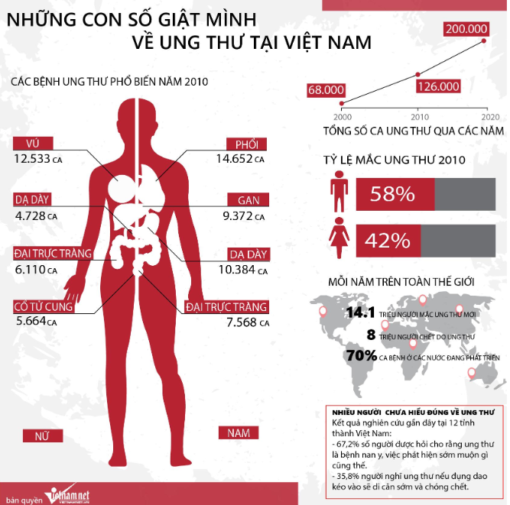
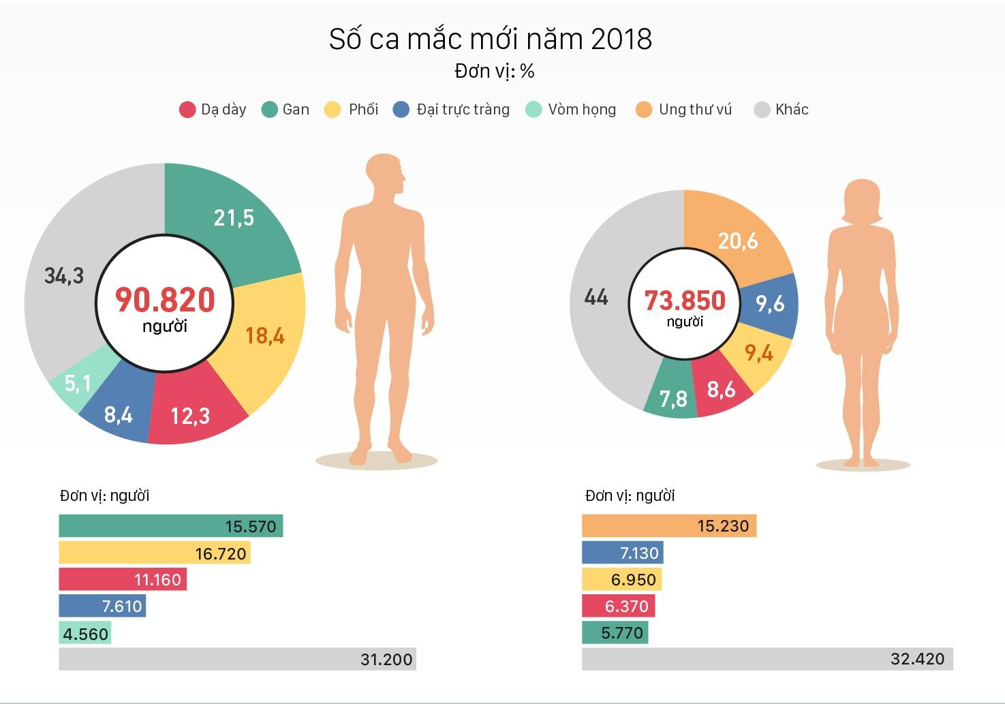
1. Introduction
Challenges
Breast cancer (BC) predicted has affected 2.3 million women worldwide in 2020, with 685,000 fatalities. Breast cancer had been detected in 7.8 million females in the previous five years as of 2020, making it the most common cancer on the planet. It causes more disability adjusted life years (DALYs) in women worldwidethan any other form of cancer[1].
Fig 2. Cancer statistics in Vietnam[15]
Notes:
According to GLOBOCAN statistics in 2020, the world is estimated to have about 19.3 million cases and 10 million deaths caused by cancer. Of which, breast cancer in women is 2.26 million cases, accounting for 11.7%.
In Vietnam, breast cancer is the leading disease among women. Because of the prevalence of this disease, there are currently many related studies being conducted with the goal of detecting and classifying breast cancer using many different methods, the most popular of which is the application of information technology in detecting and classifying abnormalities on mammograms.
Because of its popularity, there have been many research projects related to this disease in recent times.
Theo số liệu thống kê của GLOBOCAN trong năm 2020 cả thế giới ước tính có khoảng 19.3 triệu ca mắc và 10 triệu ca tử vong do ung thư gây nên. Trong đó, ung thư vú ở phụ nữ là 2.26 triệu ca chiếm 11.7%.
Tại Việt Nam ung thư vú là căn bệnh chiếm tỉ lệ hàng đầu đối với nữ giới. Chính vì mức độ phổ biến của căn bệnh này mà hiện nay có rất nhiều nghiên cứu có liên quan được thực hiện với mục tiêu phát hiện và phân loại ung thư vú bằng nhiều phương pháp khác nhau, trong đó phổ biến nhất là ứng dụng công nghệ thông tin trong phát hiện và phân loại các bất thường trên nhũ ảnh.

Slide 5
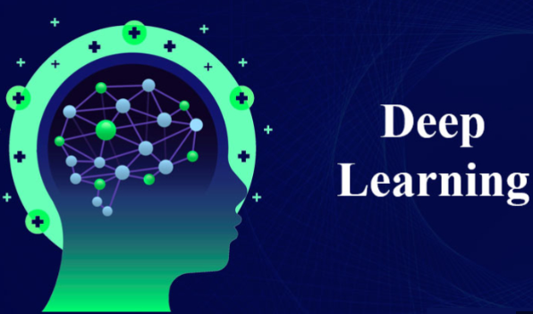


1. Introduction
Targets:
Detection and segmentation of mass on mammograms based on deep learning techniques
Install and experiment with the model, test, evaluate and compare the results.
Integrate the global explanation methods LIME and SHAP to enhance reliability and support effective decision-making
Notes:
Some of the key points our research covers are:
To achieve the above content, we briefly reviewed the research works of previous authors.

Slide 6
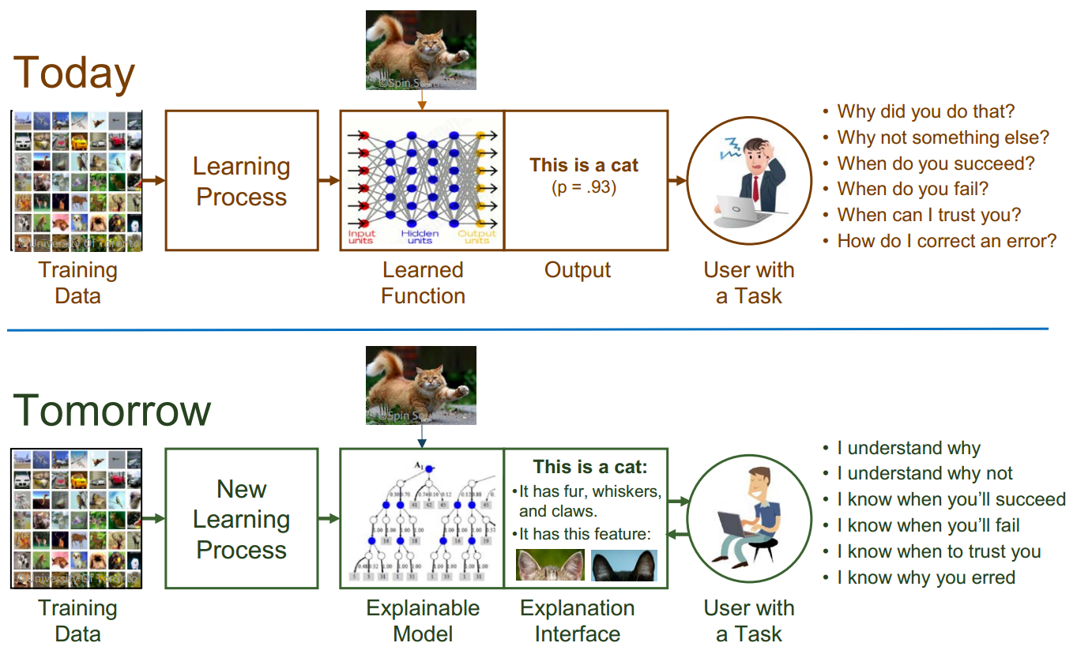
2. Related works
Explainable AI – What Are We Trying To Do?
Explainable Artificial Intelligence (XAI) - David Gunning

Slide 7
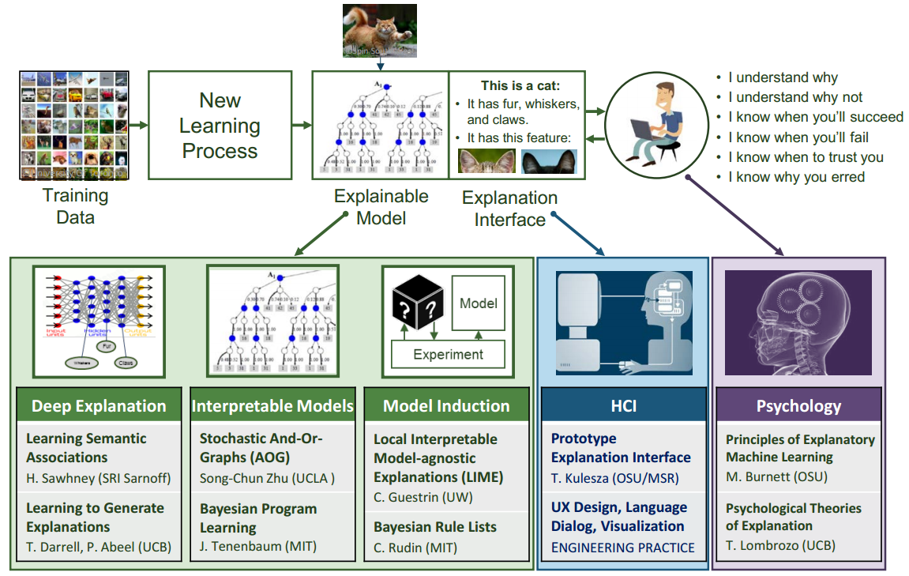
2. Related works
Explainable Artificial Intelligence (XAI) - David Gunning

Slide 8
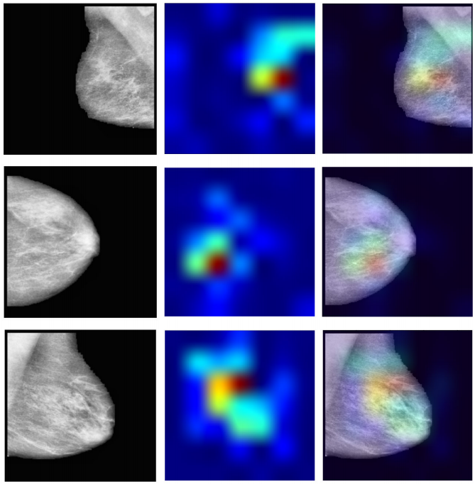
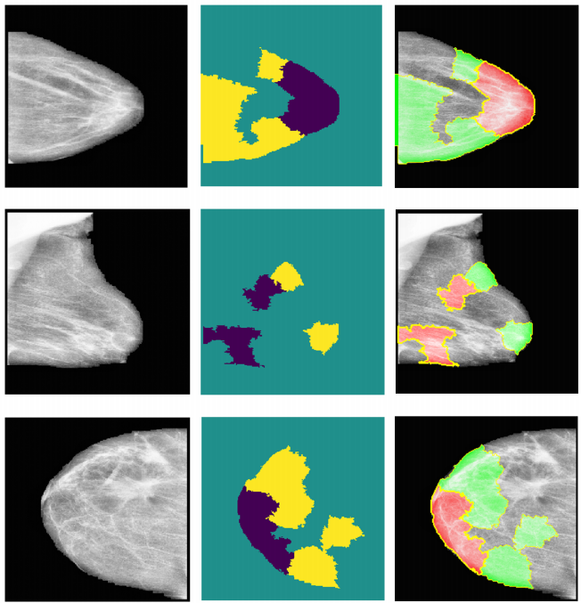
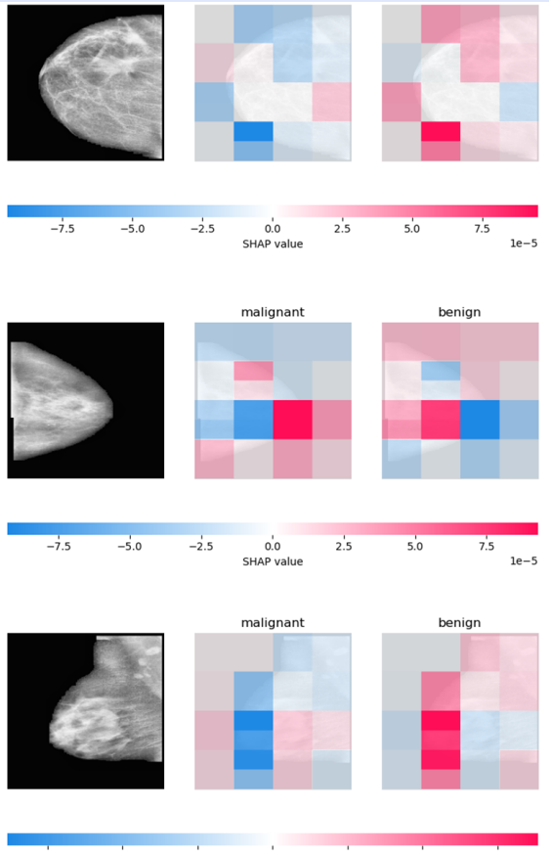
2. Related works
Model: VGG16, InceptionV3, Res-Net18
Dataset: CIBS-DDSM
Accuracy: 76%
Enhancing Breast Cancer Diagnosis in Mammography: Evaluation and Integration of Convolutional Neural Networks
and Explainable AI (Ahmed et al. 2024)
Notes:
A focal point of our study is the evaluation of XAI’s effectiveness in
interpreting model predictions, highlighted by utilising the Hausdorff measure to assess the align-ment between AI-generated explanations and expert annotations quantitatively.

Slide 9
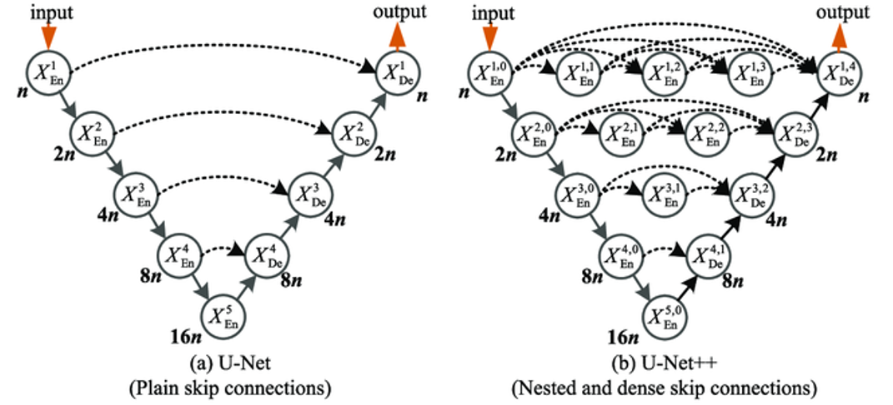
2. Related works
Fig 3. The architecture of U-Net

Slide 10
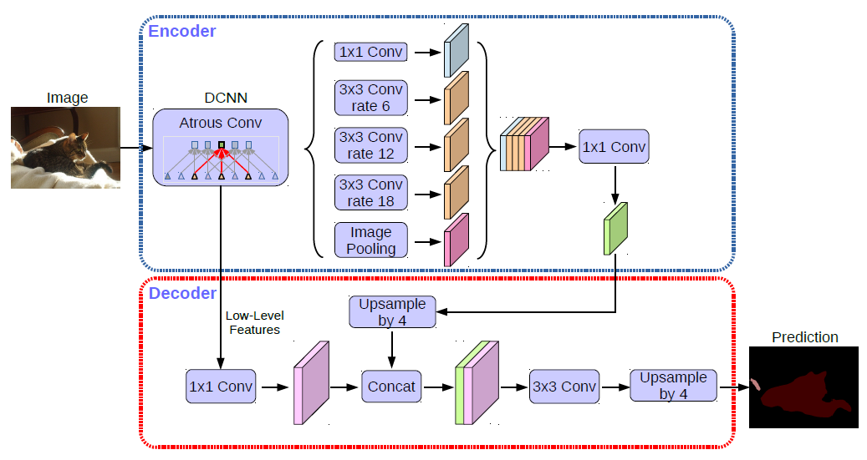
2. Related works
Fig 4. DeeplabV3+ network architecture

Slide 11
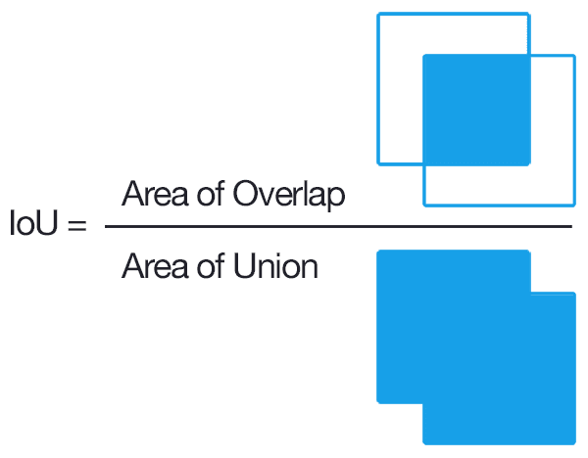

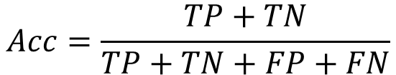



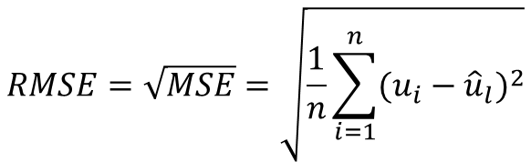



2. Related works
Evaluation metrics:
$$Acc=\frac{TP+TN}{TP+TN+FP+FN}$$
$$(1)$$
$$(2)$$
$$Dice_coef=\frac{2|Prediction ∩Ground Truth|}{\left|Prediction\right|+|Ground Truth|}$$
$$Dice Loss=1 −Dice_coef$$
$$(3)$$
$$(4)$$
$$RMSE=\sqrt{MSE}=\sqrt{\frac{1}{n}\sum_{i=1}^{n}{{(u_{i}−{\hat{u}}_{l})}^{2}}}$$
$$(5)$$
Notes:
Some metrics we use in evaluating proposed models
where u_{i} is the ground truth at pixel 𝑖, $\hat{u_{i}}$ is the predicted value at pixel 𝑖 out of total number of pixels n.

Slide 12
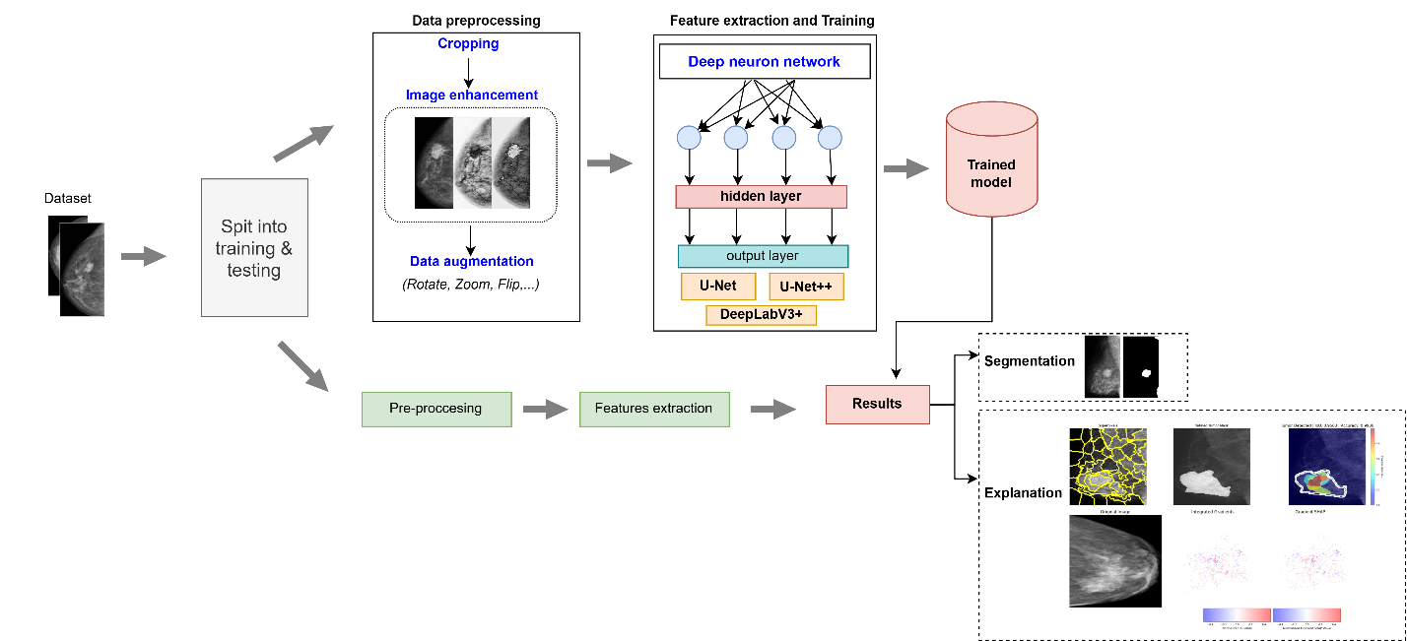
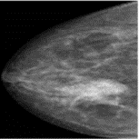
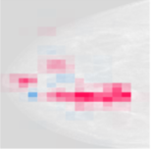
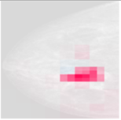
3. Proposed Method
Fig 5. A general model is proposed for breast cancer segmentation using XAI technique.
Notes:
- Pre-processing data: The input image will be normalized, stored in .jpg format and sized at 224x224. Image pre-processing is performed on the input data by normalizing the image size and enhancing the image using histogram algorithms.
- Feature extraction and convert to fuzzy rules: The processed im-ages are passed through network models to extract features. The features after the process are extracted into rule sets using the JRIP and PART algorithms presented in Section 2.3. Convert the threshold values in the rule set into fuzzy membership functions. The fuzzy dependency function in the paper presented
in Section 2.4.
The FIS system will apply the learned fuzzy rules to calculate the fuzzy outputs based on the features of the test images. Then, the defuzzifi-cation process will be performed, converting the fuzzy values into deterministic values through the weighted average method.

Slide 13
3. Proposed Method
- Data preprocessing: Input images will undergo normalization, be stored in .jpg format, and be resized appropriately for the proposed models.
- Features extraction: involves utilizing weights from trained models through transfer learning techniques, followed by fine-tuning to minimize the loss value.
- Testing phase: Following feature extraction, the dataset images are processed through the trained models to produce the corresponding outputs. The model output comprises segmentation results and output images associated with the SHAP, LIME values.
.

Slide 14
4. Experimental results
Environment: The system runs in a Python environment on Kaggle, using an Intel Xeon 2.00 GHz processor with 30GB RAM. It also utilizes a graphics processor with a 16GB RAM configuration and the Nvidia Tesla P100 GPU. Tensorflow v1.5 is the library used for network model training.
Dataset: The dataset is compiled from the VinDr dataset, supplemented with data from several hospitals. The number of images we use in the paper includes 242 benign images, 310 malignant images and 493 normal images. The dataset is divided in the ratio of 70:30.
Table 1: Proposed scenarios and training parameters
Sce. | Model | Epochs | Batch size | Learning rate
1 | U-Net | 100 | 32 | 0.0001
2 | U-Net++ | 100 | 32 | 0.0001
3 | DeepLabV3+ | 100 | 32 | 0.0001
Notes:
This dataset is divided into a training dataset and a validation dataset with a ratio of 80% and 20%, respectively. For testing, we build a hypothetical scenario where the students were doing the exam, then recorded a video, and tested it with a number of 15 videos on a cheating action to check the accuracy of the network models.
Table 1 presents the scenarios we used with the training parameters
In scenarios 2,3,5,6 we use algorithms to generate rule sets from the data extracted from the network models. The goal of this process is to improve the accuracy of the model by better handling ambiguous or contradictory cases in the data set. After conducting experiments with various sets of parameters, we selected identical parameters for all scenarios. The learning rate is set at 0.0001, with the training being conducted 100 times. The number of classes (Num classes) being 3, corresponding to benign, malignant and normal.

Slide 15
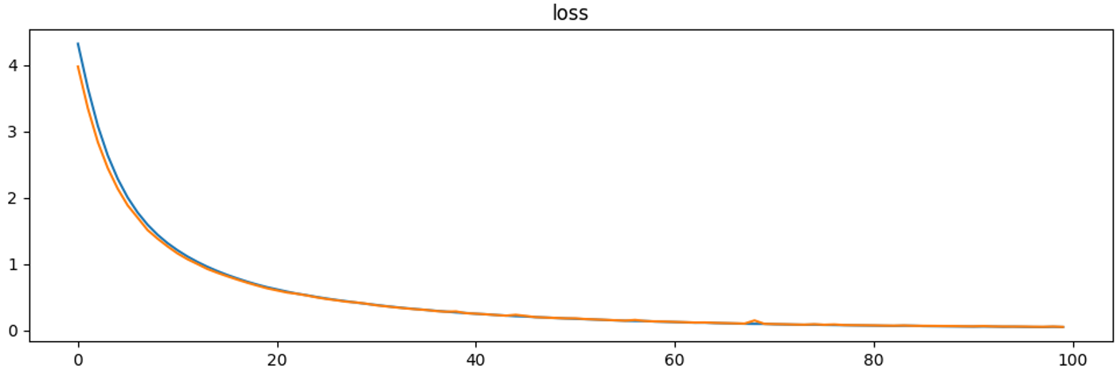
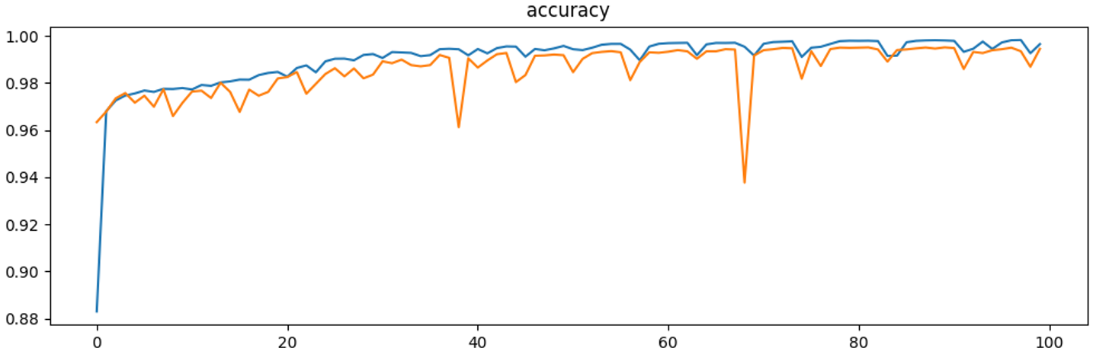
4. Experimental results
Training results
Fig 6a. The chart compares the accuracy and loss (U-Net).

Slide 16
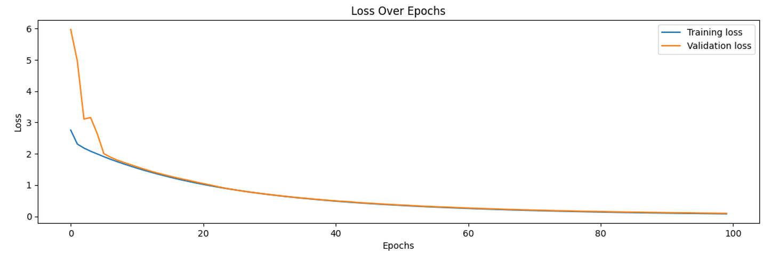
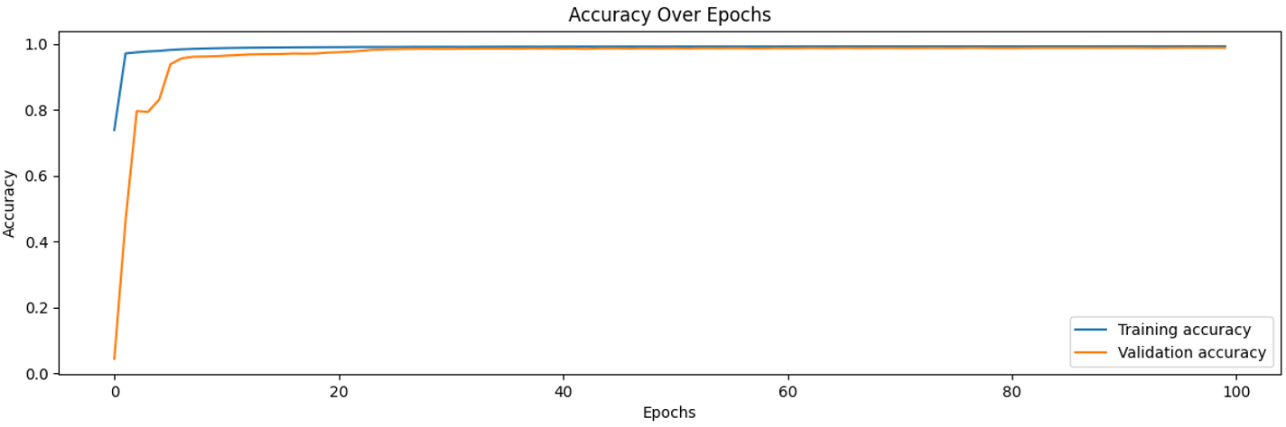
4. Experimental results
Training results
Fig 6b. The chart compares the accuracy and loss (U-Net++).

Slide 17
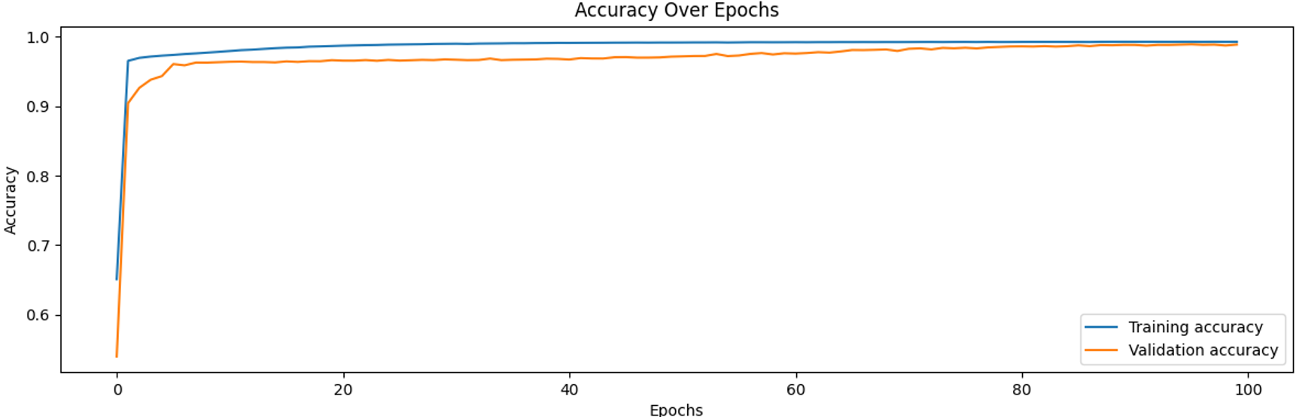
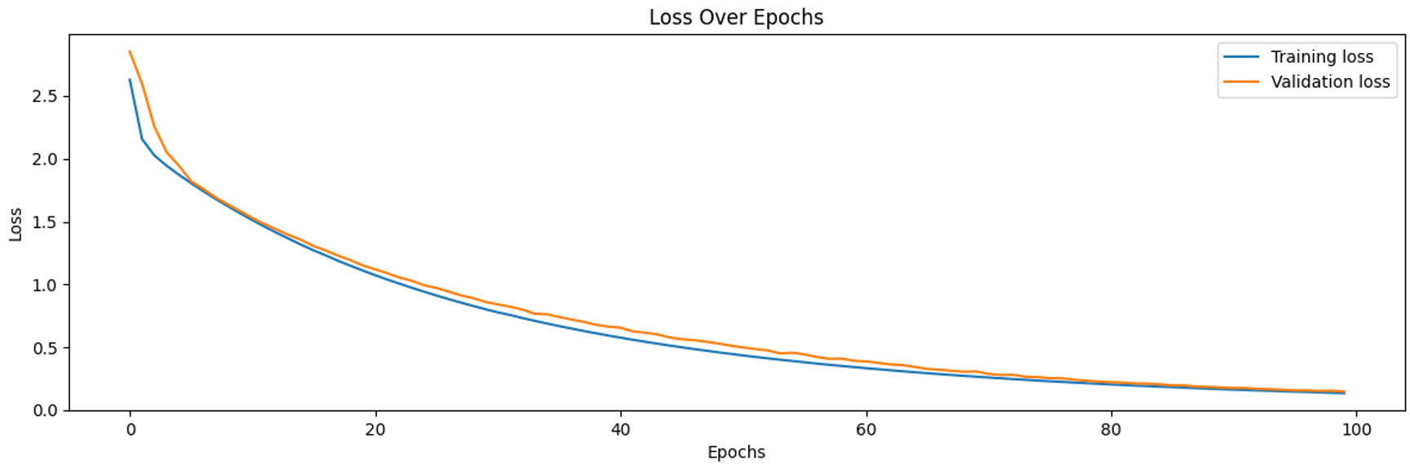
4. Experimental results
Training results
Fig 6c. The chart compares the accuracy and loss (DeepLabV3+).

Slide 18
4. Experimental results
Tab 2. Model performance evaluation results
Sce. | Model | Loss | Dice | IoU | F1-Score | RMSE | MSE | Acc
1 | U-Net | 0.1951 | 0.93 | 0.91 | 0.92 | 0.017 | 0.0003 | 0.96
2 | U-Net++ | 0.2541 | 0.88 | 0.80 | 0.87 | 0.026 | 0.0007 | 0.92
3 | DeepLabV3+ | 0.2485 | 0.92 | 0.86 | 0.91 | 0.02 | 0.0004 | 0.93
Notes:
The evaluation results of 3 scenarios indicate a generally good overall performance, with accuracy (Acc) ranging from 0.92 to 0.96. The U-Net model achieved the highest accuracy score (0.96) along with impressive metrics for Dice (0.93), IoU (0.91), and F1-Score (0.92). It also recorded very low RMSE and MSE values (0.017 and 0.0003), demonstrating its superior effectiveness in image segmentation. In contrast, U-Net++ and DeepLabV3+ exhibited slightly lower accuracy (0.92-0.93), with DeepLabV3+ achieving the lowest Loss value (0.2485) but a somewhat higher RMSE (0.026). Overall, U-Net stands out as the best model for this dataset, while DeepLabV3+ shows potential for improvement due to its low loss value.

Slide 19
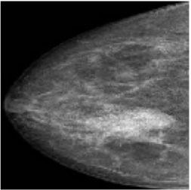

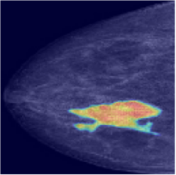
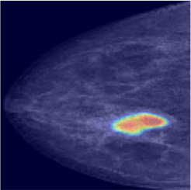
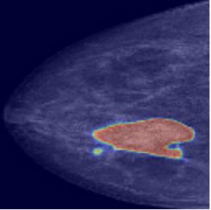
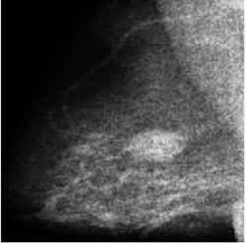

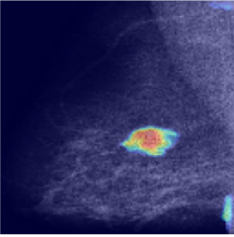
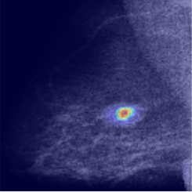
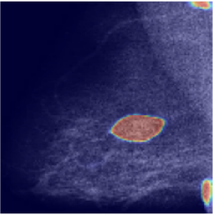
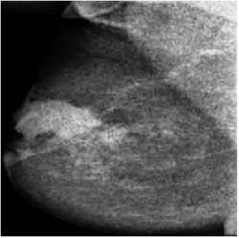

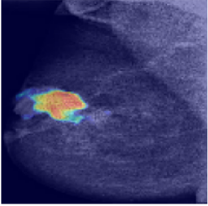
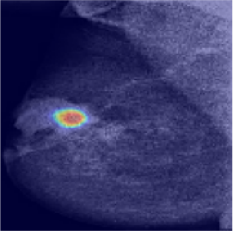
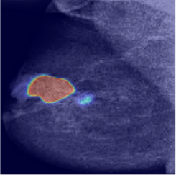
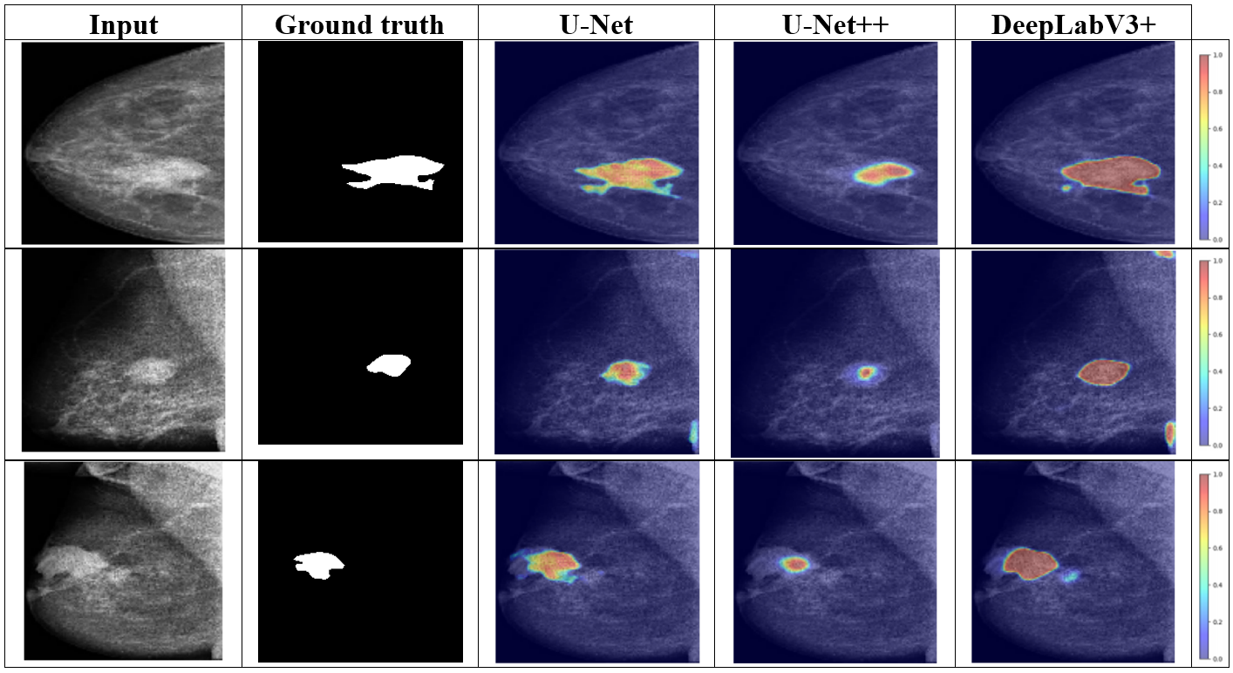
4. Experimental results
Explainable results:
Fig 7. XAI Grad-Cam interpretation results of the 3 algorithms
Notes:
The Grad-CAM results of the three scenarios show how the models focus on areas to make predictions. In the Grad-CAM heatmaps, red/yellow areas represent areas that have the greatest influence on the model's decision, while blue indicates low influence. With Sce. 1, the heatmap focuses precisely on the suspect areas in the image, with the red/yellow areas covering evenly and clearly. Sce. 3 also focuses on similar areas, but the red/yellow areas are somewhat scattered and uneven, reflecting lower performance. Meanwhile, Sce. 2 shows a rather narrow and inconsistent red/yellow focus, especially in the second and third rows, which explains why the model has a higher RMSE and lower accuracy.

Slide 20
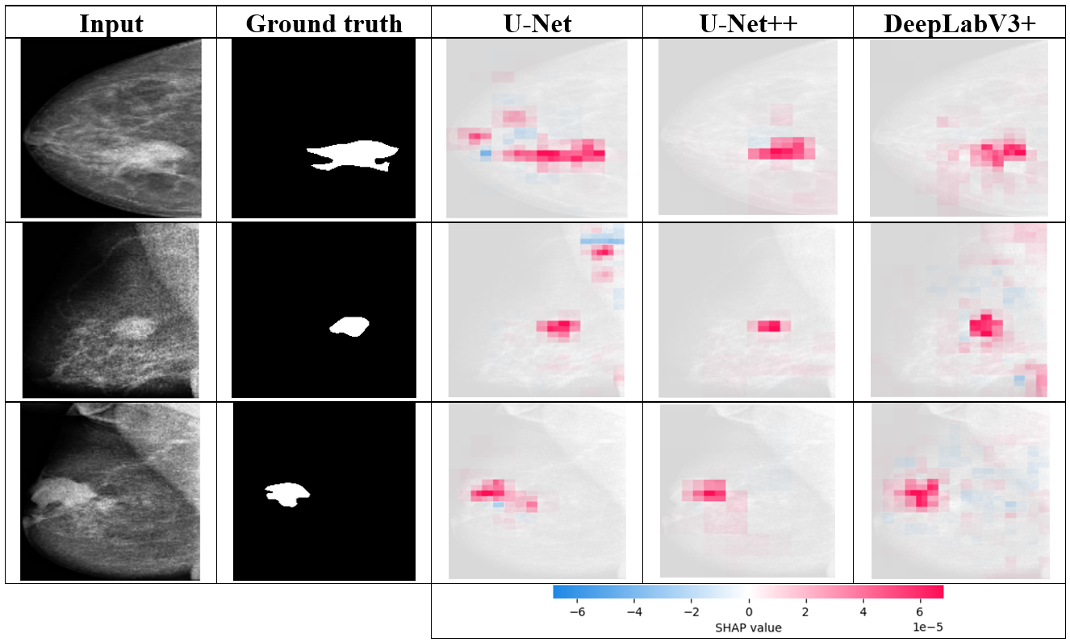
4. Experimental results
Explainable results:
Fig 8. Results explained by SHAP technique
Notes:
The SHAP results of the three scenarios on the input images show how each model focuses on image regions for prediction. In the SHAP images, red represents regions that have a strong positive impact on the model's prediction, while blue represents a negative impact.

Slide 21
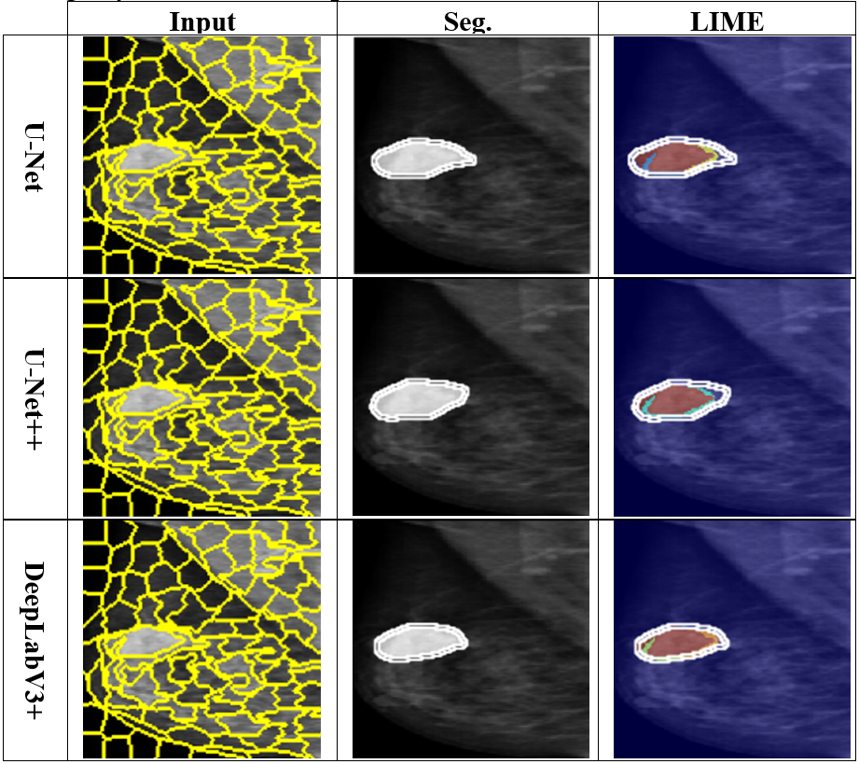
4. Experimental results
Explainable results:
Fig 9. Results explained by SHAP technique
Notes:
The LIME technical results are shown for the three scenarios, providing information on how the models make predictions. In the heatmap, yellow and red represent areas with positive influence on the prediction (high contribution), while blue or purple represent negative influence. For Sce. 1, all three models show that LIME produces clear contours over the influence areas and is well concentrated around the target area. For Sce. 3, the LIME results are also concentrated around the target area and are evenly distributed, consistent with the model performance. In Sce. 2, the LIME algorithm correctly identifies the mass area, but the region of interest is narrower than in the above two scenarios, reflecting a lower segmentation ability than in Scenarios 1 and 2.

Slide 22
5. Conclusion
We propose an effective method for segmenting mass on mammograms using U-Net, U-Net++, and DeepLabV3 algorithms.
The U-Net model gives the best results on the evaluation metrics Loss, Dice, RMSE and Acc.
The integration of XAI algorithms helps users better understand the process of deep learning networks giving results with MSE index of 0.0003 and RMSE of 0.017 (U-Net)
In the future, we will continue to develop a normal, benign, and malignant classification model to build a complete system to effectively support doctors in timely diagnosis and treatment to improve health care

Slide 23
References
[1] W. H. Organization, WHO guidelines for screening and treatment of precancerous lesions for cervical cancer prevention. World Health Organization, 2021. Accessed: May 30, 2025. [Online]. Available: https://books.google.com/books?hl=en&lr=&id=eo5FEAAAQBAJ&oi=fnd&pg=PR3&dq=World+Health+Organization.+Preventing+Cancer.+2021&ots=w1Lq6GLTc-&sig=igSf5EdoHGhK2o10aPIj6-AbJNQ
[2] M. T. Ribeiro, S. Singh, and C. Guestrin, “‘Why Should I Trust You?’: Explaining the Predictions of Any Classifier,” in Proceedings of the 22nd ACM SIGKDD International Conference on Knowledge Discovery and Data Mining, San Francisco California USA: ACM, Aug. 2016, pp. 1135–1144. doi: 10.1145/2939672.2939778.
[3] S. M. Lundberg and S.-I. Lee, “A unified approach to interpreting model predictions,” Advances in neural information processing systems, vol. 30, 2017, Accessed: May 30, 2025. [Online]. Available: https://proceedings.neurips.cc/paper/2017/hash/8a20a8621978632d76c43dfd28b67767-Abstract.html
[4] O. Ronneberger, P. Fischer, and T. Brox, “U-net: Convolutional networks for biomedical image segmentation,” presented at the Medical image computing and computer-assisted intervention–MICCAI 2015: 18th international conference, Munich, Germany, October 5-9, 2015, proceedings, part III 18, Springer, 2015, pp. 234–241.
[5] L.-C. Chen, Y. Zhu, G. Papandreou, F. Schroff, and H. Adam, “Encoder-decoder with atrous separable convolution for semantic image segmentation,” in Proceedings of the European conference on computer vision (ECCV), 2018, pp. 801–818. Accessed: May 30, 2025. [Online]. Available: http://openaccess.thecvf.com/content_ECCV_2018/html/Liang-Chieh_Chen_Encoder-Decoder_with_Atrous_ECCV_2018_paper.html
[6] H. H. Pham, H. N. Trung, and H. Q. Nguyen, “Vindr-mammo: A large-scale benchmark dataset for computer-aided detection and diagnosis in full-field digital mammography,” Sci Data, 2022, Accessed: Jun. 09, 2025. [Online]. Available: https://www.physionet.org/content/vindr-mammo/1.0.0/

Slide 24
References
[7] He, Kaiming, et al. "Deep residual learning for image recognition." Proceedings of the IEEE conference on computer vision and pattern recognition. 2016.
[8] S. Arora and A. Kaur, Modified edge detection technique using fuzzy inference system, International Journal of Computer Applications, vol. 44, no. 22, pp. 91, 2012.
[9] J. Hui, "mAP (mean Average Precision) for Object Detection", 2018.
[10] Cohen, William W., and Yoram Singer. "A simple, fast, and effective rule learner.“ AAAI/IAAI 99.335-342 (1999): 3.
[11] Quinlan, J. Ross. "Induction of decision trees." Machine learning 1 (1986): 81-106.
[12] Zadeh, Lotfi Asker. "A fuzzy-algorithmic approach to the definition of complex or imprecise concepts." International Journal of Man-machine studies 8.3 (1976):249-291.

Slide 25
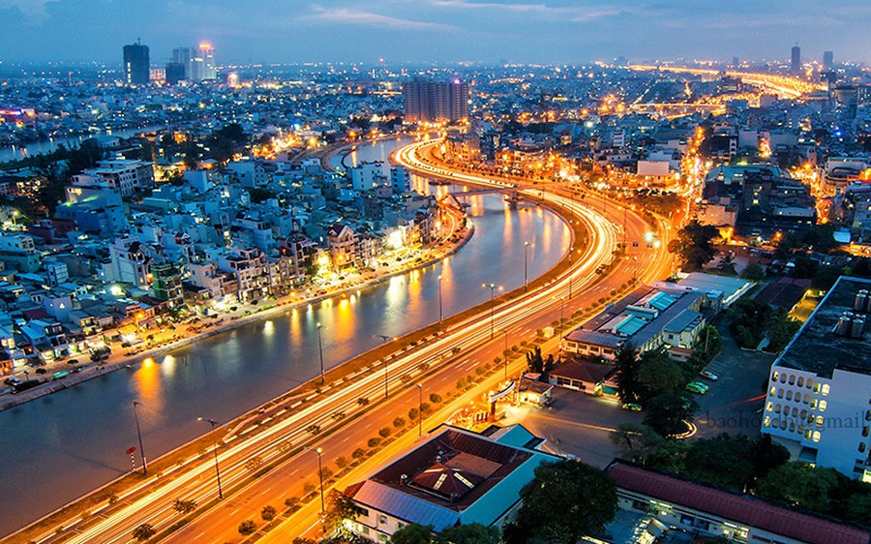
THANK YOU FOR
YOUR ATTENTION !!!

